Slide 1
Production and Emissions Impact of Household Electricity Demand Response: A CGE Assessment for Spain
Renato Rodrigues
Pedro Linares
Asociación Española para la Economía Energética (AEEE)
Vigo, January 21, 2010

Slide 2
Contents
Introduction
Electricity Demand Response Effects;
Methodology: The Economic Model;
Data and Assumptions;
Results;
Conclusion;
Future research / room for improvement.

Slide 3
Introduction
Electricity systems face important challenges in order to decrease emissions.
The electricity production mix usually includes generation units with low utilization factors (ex. peak units). This units presents higher variable costs and lower fixed costs; moreover, nowadays these technologies are based in fossil fuels, which are usually highly polluting.
Demand Response (DR) programs are an alternative to face the necessity of utilize such technologies.
  Effective price and quantity signals lower the incumbency upon the electricity production system;
  In electricity markets, DR programs have two main effects, downsizing the demand levels and/or cause its displacement through time.
Objective of the research: Provide a consistent evaluation of the impact of changes in the DR of Spanish household electricity demand. Focus on emissions effects of DR programs not only applied to the electricity sector, but also to the entire Spanish economy.

Slide 4
Electricity Demand Response Effects
Effects of increasing electricity Demand Response;
Total DR Effect
Efficiency effect:
Demand reduction effects due to the utilization of equipments in more efficient modes, per example ECO modes;
Load displacement
effect:
Displacement of load between peak and off-peak load levels due to price incentives, flattening the consumption profile.

Slide 5

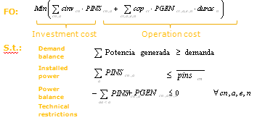








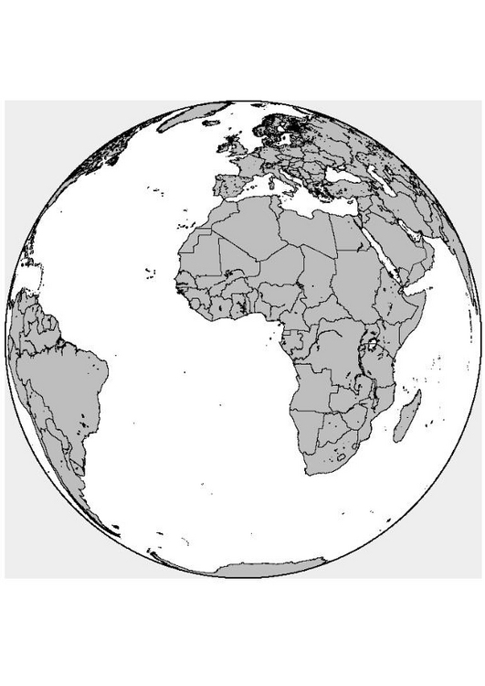
Economic Model
Active Demand Response
Demand
Response Model
Conchado & Linares (2009a) (2009b)
Electricity Consumption
Partial
Equilibrium
Model
Linares et al (2008)
Electricity
CGE Model
Rodrigues and Linares (2010)
Spain
68 Sectors
Government
Household
Agriculture
Construction
Transport
Industry
…
Etc.
Europe
Rest of
the World

Slide 6
Data and Assumptions:
Data requirements:
  Social Accountability Matrix;
  Emissions INE data;
  GTAP Substitution elasticities.
Assumptions on the Computable General Equilibrium (CGE):
  Static neoclassical formulation:
    Prices are the only signals that matters to agents;
    Agents as price-takers and flexible-prices;
    Producers are typically assumed to maximize profits subject to technological constraints operating in a perfectly competitive market within each sector;
    Private consumers represented as a single representative household that choose between consumption and savings through a maximization of their welfare subject to income constraints.
    International relationships incorporates the assumption of imperfect substitution between domestic and external products and services through an Armington Assumption. Spain is assumed price taker in the international markets.
    All savings are spent on investment goods, at fixed investment shares for each sector.

Slide 7
Results
Computable general equilibrium evaluation of Demand Response full penetration
Demand Response Effects on Emissions
CGE Effect Drivers
6,61%
1
Which production technologies will produce the electricity demanded.
2
Electricity intensiveness: electricity as an specific sector intermediate input of production.
3
Capital and labor intensiveness: Sectors intensiveness for production factors.
4
Imports-exports sectors intensiveness and exchange rate impacts
Household Demand for electricity
Partial Equilibrium
Results
General Equilibrium
Results
-3,10% | PM10 (particles) | -2,91%
-1,80% | SOx | -1,04%
-3,1% | CO2 | -0,95%
-2,9% | NOx | -0,66%
 | CH4 | -0,01%
 | N2O | 0,02%
 | CO | 0,03%
 | SF6 | 0,05%
 | VOC | 0,05%
 | NH3 | 0,06%
 | HFC | 0,07%
 | PFC | 0,11%
2
3
4
1
Primary industries (coal mining, non-metallic minerals and crude petroleum and natural gas) and traditional industrial sectors (manufacturing of cement, lime and plaster, glass, paper, rubber and plastics, metallurgy and other mineral products).
In 2000, the electricity sector was the sixth most capital intensive sector and the tenth most capital demanding sector in the Spanish economy.
Meanwhile, the electricity sector was neither intensive or great demander of labor.
Small influence due CGE assumptions.
Smaller peak load requirements -> demand supplied with cheaper production technologies ->
-> lesser costs -> lesser prices

Slide 8
Conclusions
This paper has used a CGE model of the Spanish economy to estimate the impact of implementing electricity DR programs in the economy.
There are two kinds of impacts that need to be taken in account in the evaluation of the DR policies: the direct and indirect effects.
  Direct Effects: impact sectors with larger cross input/output interaction with the electricity generation, in particular, fuel industries as natural gas and coal.
  Indirect Effects: consequences of electricity price changes over other players’ revenues and profits. The decrease on electricity costs may decrease other sectors costs as well as increase their production, consequently increasing their own electricity consumption and presenting substantial rebound effects. The same analysis can be made to indirect effects of production factors demand and prices and international trade.
The emissions analysis outline the presence of significant rebound effects under pollutants produced non predominantly by the electricity sector.

Slide 9
Future research / room for improvement
Traditional CGEs are incapable of load displacement effects assessment;
  These models are only capable of represent proportional fuel decreases in relation to the electricity demand levels;
Additional studies need to be done in order to reduce this restrictive hypothesis, which underestimate the effects of Demand Response load displacement;
Two alternative methods are been studied to developed the internalization of the load block information in the model description:
  Development of a Macro CGE model embedded with load block representation;
  Development of a Hybrid model (Bottom-up – electricity generation sector and demand structure – and Top-down – macroeconomic model).

Slide 10
END OF PRESENTATION.
COMMENTS AND QUESTIONS ARE WELCOME!
Renato Rodrigues and Pedro Linares

